Slide 1

The Shrine of Eternal Destinies
4GB - The 4 Game Brothers

Slide 2
TOC
Game Overview and Idea
Game Planning
Introduction to the Game
Demonstration
Game Outcome
Future Implementation

Slide 3
Overview
Four brothers separated at birth and sent to live with different families,
(Thief) The brother grew up and lived with his life the commoners and mastered the skill of robbing and was known as the best con artist among the commoners in the kingdom.
(Wizard) taken in by a wizard as his apprentice, he was taught the divine skill of magic at a young age while left in this mans care, through the help of his master he was taught to master the art of potion making, spellcasting, and inscription.
The brothers individually set to find their birth parents met in the jungle to realized how similar they were. They set out on a journey to find their long-lost parents that mysteriously vanished while investigating a cursed temple. It was their curiosity to find their birth parents that got them together and it’s the natural bond between them that will help them overcome the odds of cursed temple.
Kill the Boss and reunite with parents or DIE!!

Slide 4
Game Planning
In order to create this game, here are some of our influences:
The Legend of Zelda
Final Fantasy : Legend
Project Kick-Off
Repository to use (GitHub)
Test the game with every changes done to the game.
Roadmap for each week.
Roles and responsibilities of the team members.

Slide 5
Introduction to The Shrine of Eternal Destinies
Rodrigo da Silva Jalpen Desai
Software Engineer Artist / Sound Engineer
Responsible for coding, GitHub repository Responsible for making new and editing
defining coding standards, implementing art and sounds for the game. Can make
ideas from Game Designer. some coding as well.
Mohammed Mohsin Reid Williams
Project Manager + QA Game Designer
Responsible for the overall management of Responsible for defining the game
the project, track deadlines, test the game, mechanics, working directly with all other
and ensure quality submissions. Can also members to ensure consistency. Will also
code if want. design the levels and code.

Slide 6
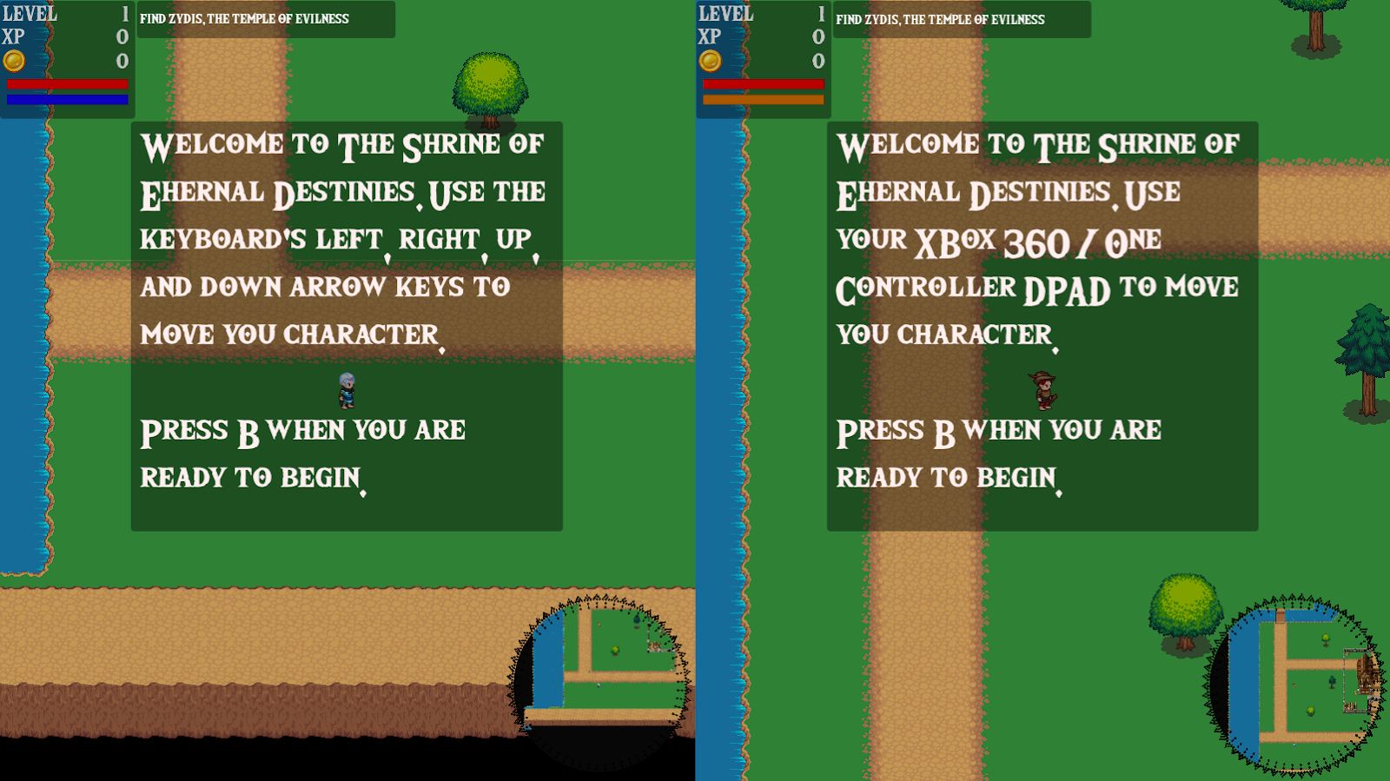
Instruction - Tutorial

Slide 7
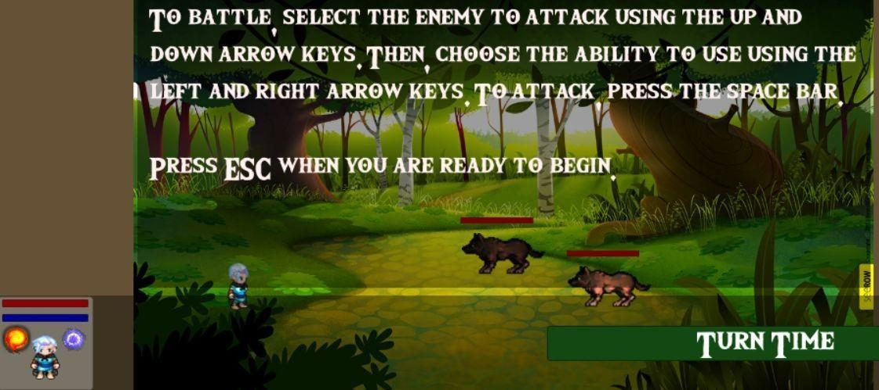
Instruction - Tutorial

Slide 8
Demonstration
WebGl Link:

Slide 9
Game Outcome

